Slide 1

Introduction to Tidytext
satRday - Cardiff - 23rd June 2018
Nujcharee Haswell
North Yorkshire County Council

Slide 2
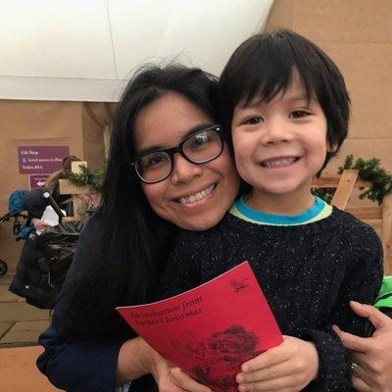
Hi - I am Nujcharee (Ped)
Data & Intelligence Specialist / Data Scientist
North Yorkshire County Council
Experience: 10+ Years Data Warehouse, Business Intelligence, Data Engineering and Data Science ( <1 year)
NASA Datanaut Spring 2017

Slide 3
Let’s get to know tidytext
Online Book: https://www.tidytextmining.com/

Slide 4
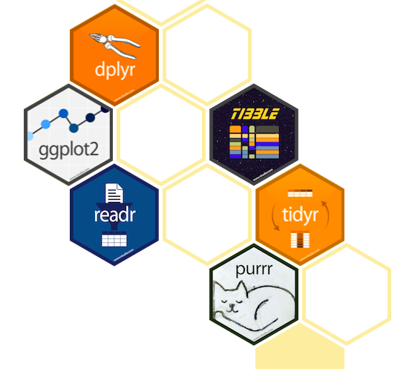
About tidy data principle
Using tidy data principles is a powerful way to make handling data easier and more effective, and this is no less true when it comes to dealing with text. As described by Hadley Wickham (Wickham 2014), tidy data has a specific structure:
Each variable is a column
Each observation is a row
Each type of observational unit is a table
Online Book: https://www.tidytextmining.com/

Slide 5
Why text mining?
Because we want to apply simple interpretation of natural language

Slide 6
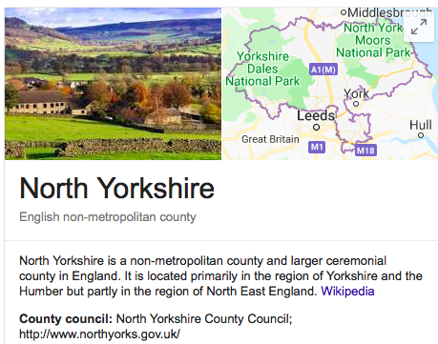
My tidytext story
How I use tidytext to solve problems
Analyse staff survey for better engagement
Better understand reasons for delay transfer of care (DToC)
Spam / Non Spam email classifications
Build knowledge management system
Notes:
Why do we do text mining?

Slide 7
Let’s explore tidytext package in 3 steps
Step 1:
Tidy and Tokenising words
Step 2:
Sentiment Analysis
Step 3:
Word Frequency vs TDF-IDF
Notes:
Why do we do text mining?

Slide 8
Step 1: Tidy (our) text
Data acquisition
Many R Packages from scraping text data
rtweet for tweets extraction
textreadr, officeR for office files text extraction
Kaggle
data.world
Notes:
Why do we do text mining?

Slide 9
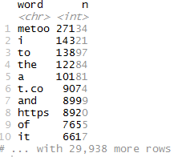
unnest_token
Break text into individual tokens (a process called tokenisation) and transform it to a tidy data structure (one-word-per-row format )
tokens <- dataset %>%
unnest_tokens(word, text)%>%
count(word, sort = TRUE)
Notes:
Where we want to tokenise “text” column on dataset data frame and place it as word column in the newly created object called tokens.

Slide 10
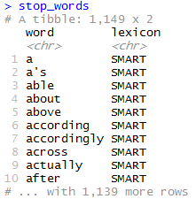
stop_words
Remove stop words from our tokens.
We can also create custom stop words.
tokens <- dataset %>%
unnest_tokens(word, text) %>%
anti_join(stop_words)
Notes:
Why do we do text mining?

Slide 11
library(tidytext) ## to carry out text mining tasks
library(dplyr) ## for tidy tool
library(wordcloud) ## for visualisation
clean_metoo <- metoo %>%
unnest_tokens(word, text) %>%
anti_join(stop_words)
#### customised stop words
custom_stop_words <- bind_rows(data_frame(word = c(“metoo”),
lexicon = c(“custom”)), stop_words)
## re-run
clean_metoo <- metoo %>%
unnest_tokens(word, text) %>%
anti_join(custom_stop_words)

Slide 12
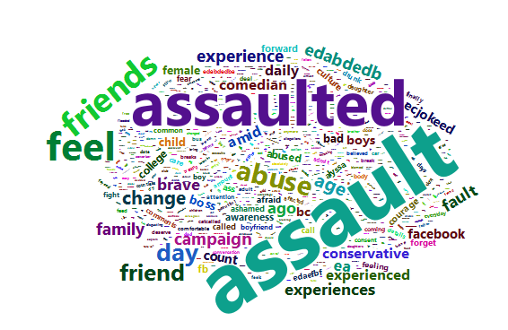
## quick glance on most frequent words
wordcloud(word, n, max.words = 100))

Slide 13
Step 2: Sentiment Analysis
Lexicon - words are assigned scores for positive/negative sentiment, and also possibly emotions like joy, anger, sadness
nrc
AFINN
bing
Notes:
Why do we do text mining?

Slide 14
get_sentiments
get_sentiments("bing")
## # A tibble: 6,788 x 2 ## word sentiment ## <chr> <chr> ## 1 2-faced negative ## 2 2-faces negative ## 3 a+ positive ## 4 abnormal negative ## 5 abolish negative ## 6 abominable negative ## 7 abominably negative ## 8 abominate negative ## 9 abomination negative ## 10 abort negative ## # ... with 6,778 more rows
get_sentiments("nrc")
## # A tibble: 13,901 x 2 ## word sentiment ## <chr> <chr> ## 1 abacus trust ## 2 abandon fear ## 3 abandon negative ## 4 abandon sadness ## 5 abandoned anger ## 6 abandoned fear ## 7 abandoned negative ## 8 abandoned sadness ## 9 abandonment anger ## 10 abandonment fear ## # ... with 13,891 more rows
get_sentiments("afinn")
## # A tibble: 2,476 x 2 ## word score ## <chr> <int> ## 1 abandon -2 ## 2 abandoned -2 ## 3 abandons -2 ## 4 abducted -2 ## 5 abduction -2 ## 6 abductions -2 ## 7 abhor -3 ## 8 abhorred -3 ## 9 abhorrent -3 ## 10 abhors -3 ## # ... with 2,466 more rows

Slide 15
inner_join
metoo_sent <- clean_metoo %>%
unnest_tokens(word, text) %>%
anti_join(stop_words) %>%
inner_join(get_sentiments("bing")) %>% count(word, sentiment, sort = TRUE) %>%
acast(word ~ sentiment, value.var = "n",
fill = 0) %>% comparison.cloud(colors = c("gray20", "gray80"), max.words = 100)

Slide 16
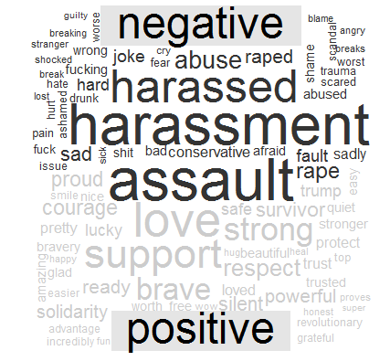
comparison.cloud

Slide 17
Step 3: word counts vs TF-IDF
Words occur frequently in a document != important
TF-IDF = Combination of term frequency(tf) and inverse document frequency (idf)
Notes:
Why do we do text mining?

Slide 18
TF - Term Frequency
TF measures how frequently a term occurs in a document.
Term frequency is often divided by the total number of terms in the document as a way of normalization.

Slide 19
IDF - Inverse document frequency
IDF measures how important a term is. While computing TF, all terms are considered equally important.
TF-IDF finds the important words for the content of each document by decreasing the weight for commonly used words and increasing the weight for words that are not used very much in a collection or corpus of documents

Slide 20
bind_tf_idf
Find the words most distinctive to each document
bigram_tf_idf <- bigrams_united %>%
count(location, bigram) %>%
bind_tf_idf(bigram, location, n) %>%
arrange(desc(tf_idf))
Notes:
Why do we do text mining?

Slide 21
bigram
Tokenise pairs of two consecutive words to explore how often word X is followed by word Y, we can then build a model of the relationships between them.
metoo_bigrams <- dataset %>%
unnest_tokens(bigram, text, token = "ngrams", n = 2) %>%
count(source_r, bigram, sort = TRUE)
Notes:
Why do we do text mining?

Slide 22
Step 4: case study
Metoo
Notes:
Why do we do text mining?

Slide 23
Summary
Step 1 - Get data, tokenisation process
unnest_tokens
anti_join(stop_words)
get_stopwords
Step 2 - Sentiment Analysis
get_sentiments(“lexicon”)
inner_join(get_sentiments("bing"))
Step 3
bind_tf_idf
unnest_tokens(bigram, text, token = "ngrams", n = 2)
Notes:
Why do we do text mining?

Slide 24
Useful resources
Online Book: https://www.tidytextmining.com/
cleanNLP - NLP with tidy principle wrap
spacyR - R wrapper package for Python’s spaCy NLP
hunspell - for spelling check
Notes:
Why do we do text mining?

Slide 25

Thank you
satRday organiser and sponsor @LockeData
Steph Locke for first time speaker tips & advice
#rstats community & #NASADatanauts
North Yorkshire County Council
All of you for joining me
Notes:
Why do we do text mining?

